Slide 1
KINETIC THEORY OF GASES

Slide 2
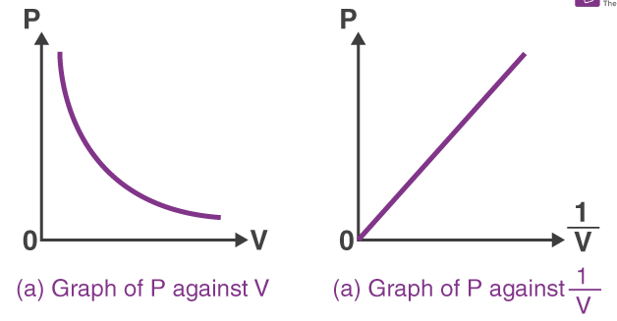

Boyle’s law
PV = K constant
∴ P1V1 = P2 V2
Boyle’s Law :
Pressure of a given ideal gas is inversely proportional to its volume if temperature is kept constant.
Charle’s Law :
Volume of given ideal gas is directly proportional to its temperature in kelvin if pressure is kept constant.

Slide 3
Gay Lussac’s Law :
Pressure of an ideal gas is directly proportional to its absolute temperature if volume is kept constant.
Avogadro’s Law :
Equal volume of all the gases under similar conditions of temperature and pressure contain equal number of molecules.
N₁T₁ N₂ T₂
Ideal gas equation connecting the variables is

Slide 4
Dalton’s Law of Partial Pressure :
Total pressure of a mixture of non-reactive gases is the sum of their partial pressure.
Average Velocity :
Since gas molecules moves randomly in all possible directions so average velocity of gas molecules is zero.
Average displacement of all molecules is zero.

Slide 5
Mean speed :
Mean speed or average speed is the arithmetic mean of the speeds of molecules in a gas at a given temperature.
Mean Square Velocity :
Mean square velocity is defined as the average of the square of the velocities of all molecules. Let v1, v2, …. vN be the velocities of N molecules of a gas. Then mean square velocity
Root mean square velocity (R.M.S. velocity) :
The square root of the average of the squares of the velocities of gas molecules is called the R.M.S. velocity.

Slide 6
Ideal Gas Equation
For m mols For 1 gm. mol
PV = NAkT
PV = RT
PV = Rt
(NA.k = R)
[k is Bolzman constant]
For one gram of gas
Values of R, its unit and dimensions :
R = 2 Calorie mol^{-1o}C⁻¹
R = 8.31 Joulemol^{-1o}C⁻¹
R = 8.31 x 10⁷ erg mol^{-1o}C⁻¹ Unit SI : Joule mol⁻¹K⁻¹ Dimensions : ML²T⁻²q⁻¹ mol⁻¹

Slide 7
ASSUMPTIONS OF THE KINETIC THEORY OF GASES :
The kinetic theory of gases is based on the following assumptions :
All the molecules of a gas are identical as regarding their shape and mass. The molecules of different gases are different.
The molecules are rigid and perfectly elastic spheres of very small diameters.
Gas molecules occupy very small space. The actual volume occupied by the molecule is very small compared to the total volume of the gas. Therefore volume of the gas is equal to volume of the vessel.

Slide 8
The molecules are in a state of random motion, i.e., they are constantly moving with all possible velocities in all possible directions.
Normally no force acts between the molecules. Hence they move in straight lines with constant speeds.
The molecules can have all possible velocities lying between zero and infinity

Slide 9
The molecules collide with one another and also with the walls of the container and change their direction and speed due to collision. These collisions are perfectly elastic i.e., there is no loss of kinetic energy in these collisions.
The molecules do not exert any force of attraction or repulsion on each other except during collision. So, the molecules do not posses any potential energy. Their energy is wholly kinetic.

Slide 10
The collisions are instantaneous i.e., the time spent by a molecule in a collision is very small as compared to the time elapsed between two consecutive collisions.
Though the molecules are constantly moving from one place to another, the average number of molecules per unit volume of the gas remains constant
The molecules inside the vessel keep on moving continuously in all possible directions, the distribution of molecules in the whole vessel remains uniform.

Slide 11
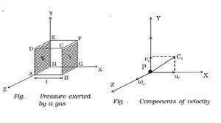
The mass of a molecule is negligibly small and the speed is very large, there is no effect of gravity on the motion of the molecules. If this effect were there, the density of the gas would have been greater at the bottom of the vessel.
Pressure exerted by a gas

Slide 12
Average K.E. of translation per unit volume of the gas
Kinetic interpretation of temperature.

Slide 13
R.M.S velocity of gas molecules
Average R.M.S and most probable speed
If V1, V2, V3…….Vn are the speed of n gas molecules then average speed

Slide 14
It can be shown that
Most probable speed [Vmp]
The speed possessed by the maximum number of molecules in a gas sample at a given tempt

Slide 15
Degrees of freedom
The number of degrees of freedom of the system is
N – number of particles in the system
f = 3N – K.
K – number of independent relations between the particles
For mono atomic gas
For diatomic gas
For triatomic gas
N = 1 K = 0 so f = 3 x 1 – 0 = 3
N = 2 K = 1 so f = 3 x 2 – 1 = 5
N = 3, N = 2 so f = 3 x 3 – 3 = 6
[Nonlinear molecules – H2O, SO2 etc.]

Slide 16
For linear molecule (CO2, CS2, etc) f = 3N – K= 3 x 3 – 2 = 7
Specific heat of a poly atomic gas
Average energy of each molecule

Slide 17
Mean free path
If a particle covers free path 1, 2 …. After successive collisions then its mean free path
Specific heat of diatomic gas

Slide 18
Specific heat of triatomic gas
Triatomic gas 6 degrees of freedom
Law of equipartition of energy
The average K.E per molecule per degree of freedom

Slide 19
Specific heat of mono atomic gas.
Mono atomic gas – 3 degrees of freedom
∴ Average energy associated with three degrees of freedom
Total internal energy of one mole of a mono atomic gas

Slide 20

Perfect gas equation
Pv = nRT
P – Pressure; V –Volume; T –Temperature; n – Number of moles of the gas; R – universal gas constant
Values of R = 8.31 J mole⁻¹ K⁻¹ = 1.98 cal mole⁻¹ Oc⁻¹

Slide 21
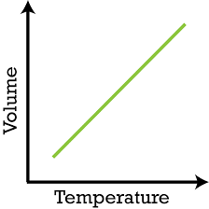
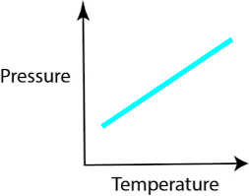
Charles’ law
V 𝖺 T
Gay Lussa’s law of pressure
P 𝖺 T

Slide 22
The volume of a gas at 20°C is 200 ml. If the temperature is reduced to - 20°C at constant pressure, its volume will he
1. 172.6 ml 2. 17.26 ml 3. 192.7 ml 4. 19.27 ml
2. Which of the following quantities is zero on an average for the
molecules of an ideal gas in equilibrium?
1. kinetic energy 2. momentum
3. density 4. speed

Slide 23
The mean free path of gas molecules depends on
(d - molecular diameter)
1. d 2. d2 3. 42 4. d⁻¹
4. A gas behaves more closely as on ideal gas at
1. low pressure and low temperature
2. low pressure and high temperature
3. high pressure and low temperature
4. high pressure and high temperature

Slide 24
Which of the following statements about kinetic theory of gases
is wrong
1. The molecules of a gas are in continuous random
motion
2. The molecules continuously undergo inelastic
collisions
3. The molecules do not interact with each other
except during collisions
4. The collisions amongst the molecules are of short
duration

Slide 25
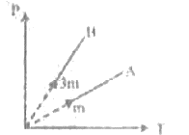
Figure shows graphs of pressure vs density lor an
ideal gas at two temperatures T₁ and T₂.
1. T₁>T₂ 2. T₁=T₂
3. T₁<T₂ 4. any of the three is possible

Slide 26
7. If a Vander-Waal’s gas expands freely, then final temperature is
1. Less than the initial temperature
2. Equal to the initial temperature
3. More than the initial temperature
4. Less or more than the initial temperature depending on the nature of the gas

Slide 27
A gas at the temperature 250 K is contained in a closed vessel.
If the gas is heated through 1K, then the percentage increase in
its pressure will be
1. 0.4% 2. 0.2% 3. 0.1% 4. 0.8%

Slide 28
Consider a mixture of oxygen and hydrogen kept at room temperature. As compared to a hydrogen molecule an oxygen molecule hits the wall
1. With greater average speed
2. with smaller average speed
3. with greater average kinetic energy
4. with smaller overage kinetic energy

Slide 29
Consider the quantity MkT/pV of an ideal gas where M is the mass
of the gas. It depends on the
1. temperature of the gas
2. volume of the gas
3. pressure of the gas
4. nature of the gas

Slide 30

The number of molecules in a gas at pressure 1.64x10⁻³
atmospheres and temperature 200 K having the volume | cc are
1. 6.02x10¹⁶ 2. 2.63x10¹⁶ 3. 3.01x10¹⁹ 4. 12.04x10¹⁹
The ratio of die mean speed of hydrogen molecules to the mean speed of nitrogen molecules in a sample containing a mixture of the two gases
1.$\sqrt{14}$ 2.$\sqrt{7}$ 3.$\sqrt{28}$ 4. None of these

Slide 31

Three closed vessels A, B, and C are at the same temperature T
and contain gases which obey the Maxwellian distribution of
velocities. Vessel A contains only O₂, B only N₂, and C a mixture of
equal quantities of O₂ and N₂, If the average speed of O₂ molecules in
vessel A is V₁, that of the N2 molecules in vessel B is V₂, the average
speed of the O₂ molecules in vessel C will be
1. (V₁+V₂)/2 2. V₁
3. (V₁V₂)^{1/2} 4. $\sqrt{3kT∕M}$

Slide 32
1 mole of gas occupies of 100 ml at 50 mm pressure. What is
the volume occupied by two moles of gas at 100 mm pressure and
at same temperature
1. 50 ml 2. 100 ml 3. 200 ml 4. 500 ml
A flask is filled with 13 gm of an ideal gas at 27⁰C its temperature is raised to 52⁰C. The mass of the gas that has to be released to maintain the temperature of the gas in the flask at 52⁰C and the pressure remaining the same is
1. 2.5g 2. 2.0g 3. 1.5g 4. 1.0g

Slide 33
16. Three containers of the same volume contain three different gases. The masses of the molecules are m₁, m₂ and m₃ and the number of molecules in their respective containers are N₁, N₂ and N₃. The gas pressure in the containers are P₁, P₂ and P₃ respectively. All the gases are now mixed and put in one of the containers. The pressure P of mixture will be
P<(P₁+P₂+P₃) 2.
3. P=(P₁+P₂+P₃) 4. P>(P₁+P₂+P₃)

Slide 34
17. Air pumped into an automobile tube upto a pressure of 300 kPa in the morning when the air temperature is 22⁰C. During the day, temperature rises to 40⁰C and the tube expands by 2%. The pressure of the air in the tube at this temperature, will be approximately, will be approximately
1. 212 kPa 2. 209 kPa 3. 206 kPa 4. 200 kPa

Slide 35

18. To what temperature should the hydrogen at 327°C be cooled at constant pressure, so that the root mean square velocity of its molecules become hair of its previous value
  -123⁰C 2. 123⁰C 3. -100⁰C 4. 0⁰C
19. The root mean square velocity of a gas molecule of
mass m at a given temperature is proportional to
1. m⁰ 2. m 3. 4.

Slide 36
20. At room temperature, the r.ras. speed of the molecules of
certain diatomic gas is found to be 1930 m/s. The gas is
1.H₂ 2. F₂ 3. O₂ 4. Cl₂
21. According to the kinetic theory of gases the r.m.s. velocity of
gas molecules is directly proportional to
1. T 2. 3. 4.

Slide 37
22. r.m.s. velocity of nitrogen molecules at NTP is
1. 492 m/s 2. 517 m/s 3. 546 m/s 4. 33 m/s
23. The root mean square speed of the molecules of a gas is
1. Independent of its pressure but directly proportional to its Kelvin temperature
2. Directly proportional to the square roots of both its pressure and its Kelvin temperature
3. Independent of its pressure but directly proportional to the square root of its Kelvin temperature
4. Directly proportional to both its pressure and its Kelvin temperature

Slide 38


24. Let A and B the gases and given: ; where it is the temperature and M is molecular mass, if C_{A} and C_{B} are the r.m.s. speed, then the ratio will be equal to
1. 2 2. 4 3. 1 4. 0.5

Slide 39
25. To double the volume of a given mass of an ideal gas at 27⁰C
keeping the pressure constant, one must raise the temperature
in degree centigrade to
1. 54⁰ 2. 270⁰ 3. 327⁰ 4. 600⁰

Slide 40
26. A mass of an ideal gas undergoes a reversible isothermal
compression. Its molecules will then have compared with initial
state, the same
(i) root mean square velocity
(ii) mean momentum
(iii) mean kinetic energy
1. (i), (ii), (iii) correct 2. (i), (ii) correct
3. (ii), (iii) correct 4. (i) correct

Slide 41
27. Volume of gas become four times if
1. Temperature become four times at constant pressure
2. Temperature become one fourth at constant
pressure
3. Temperature becomes two times at constant
pressure
4. Temperature becomes half at constant pressure

Slide 42
28. Kinetic theory of gases provide a base for
1. Only Charle’s law 2. Only Boyle’s law
3. Charle’s law and Boyle’s law 4. None of these
29. I fan ideal gas has volume V at 27°C and it is heated at a
constant pressure so that its volume becomes 1.5V Then die value
of final temperature will be
1. 600°C 2. 177°C 3. 817°C 4. None of these

Slide 43
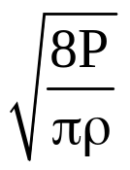
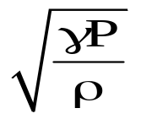
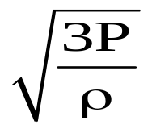
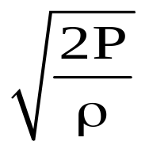
30. Match List-I and List-II and select the correct answer.
List-I |  | List-II
a. | Root mean square speed | i.
b. | Most probable speed | ii.
c. | Average speed | iii.
d. | Speed of sound in a gas | iv.
1. a→(ii), b→(iv), c→(i), d→(iii)
2. a→(i), b→(ii). c→(iii), d→(iv)
3. a→(iv), b→(iii), c→(ii), d→(i)
4. a→(iii), b→(iv), c→(i), d→(ii)

Slide 44

Thank you…

